Slide 1
Vehicle Insurance Claims Analysis
Aditya Satpute

Slide 2
Why Vehicle Insurance Claim data analysis
To understand policy holder demographics
Patterns or relationships between attributes
Scrutinize applications with certain characteristics
Provide insights to vehicle makers for targeted advertising
Fraud characteristics

Slide 3
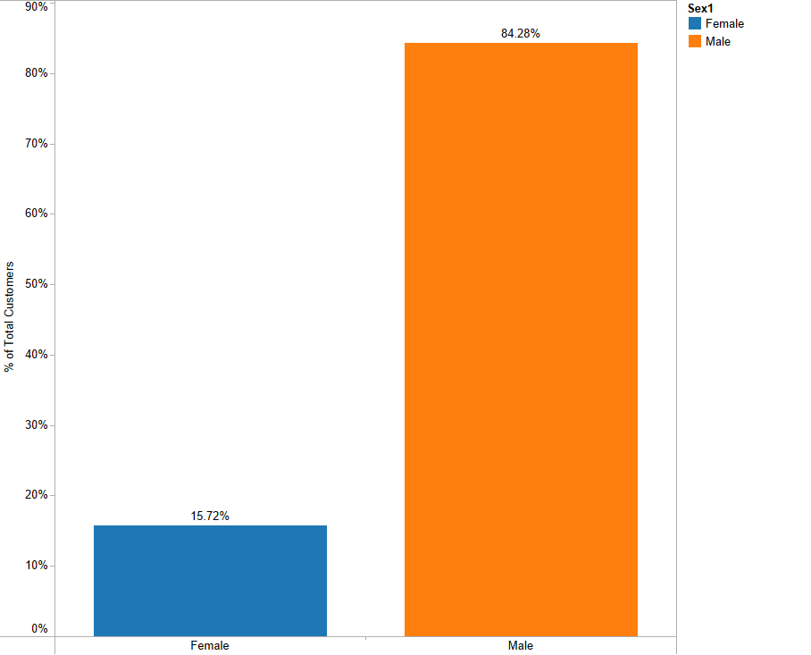
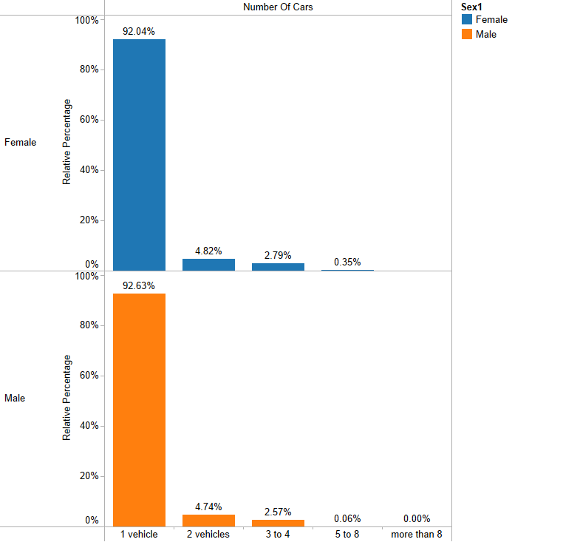
Customer demographics

Slide 4
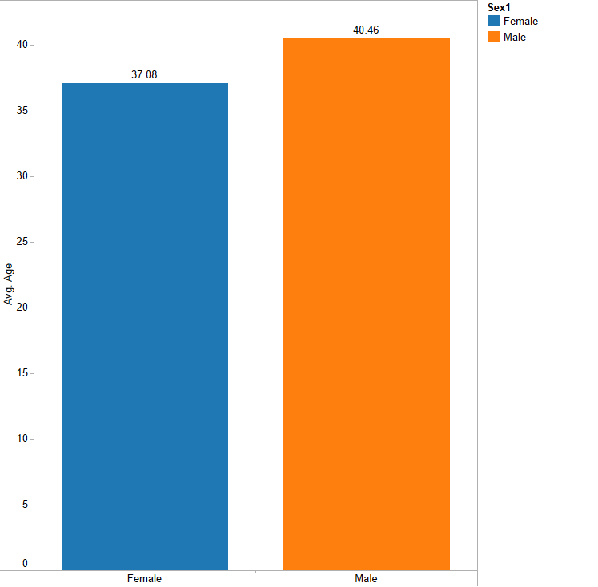
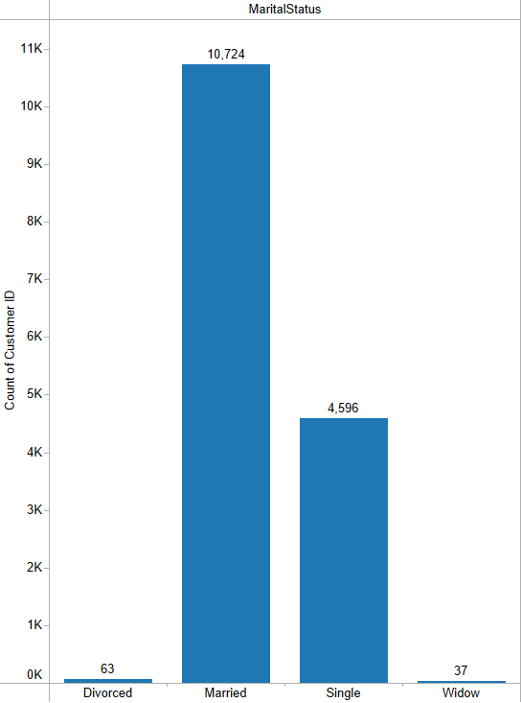
Customer Demographics

Slide 5
Car Makes and top car category

Slide 6
Most represented price category

Slide 7
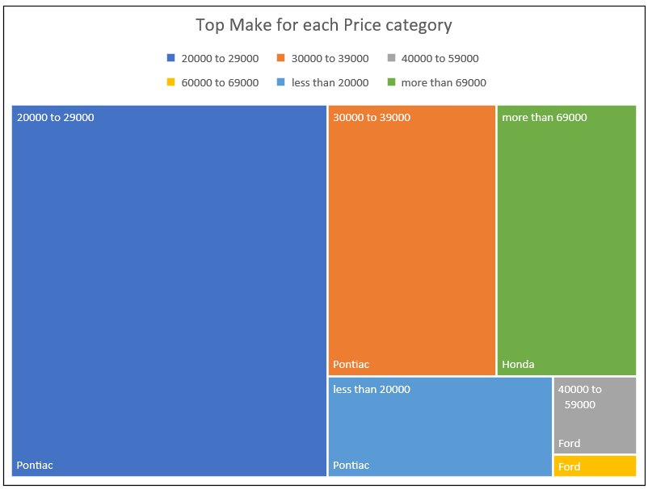
Top make for each price category

Slide 8
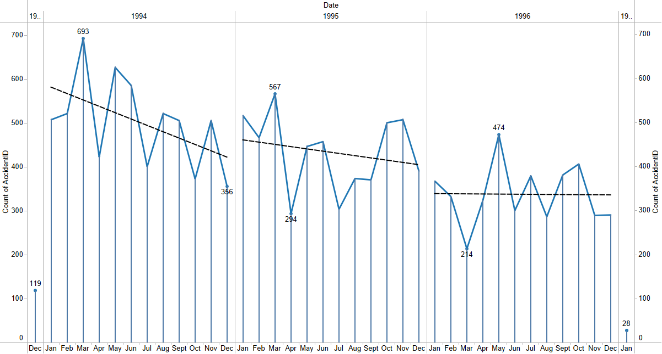
Is there seasonality in accident claims

Slide 9
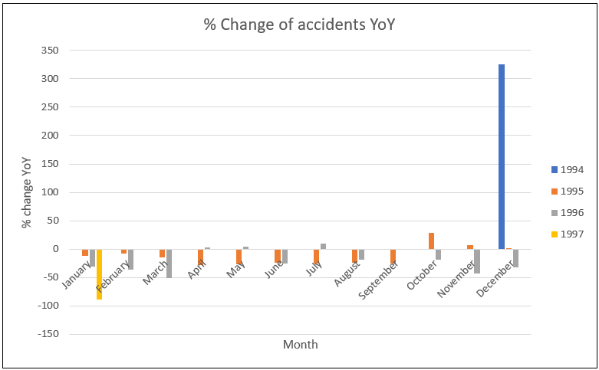
Accident trends

Slide 10
Fraudulent claims analysis

Slide 11
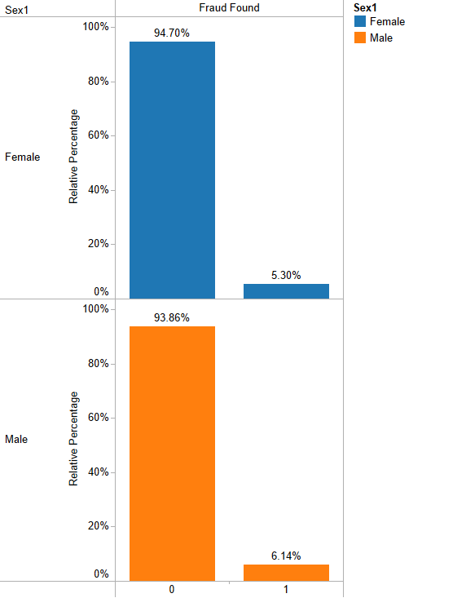
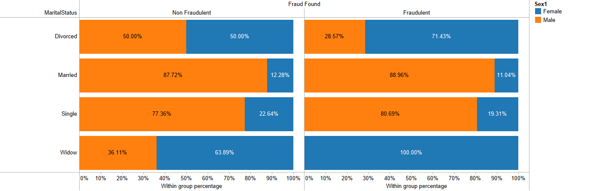
Fraudulent Claim characteristics

Slide 12
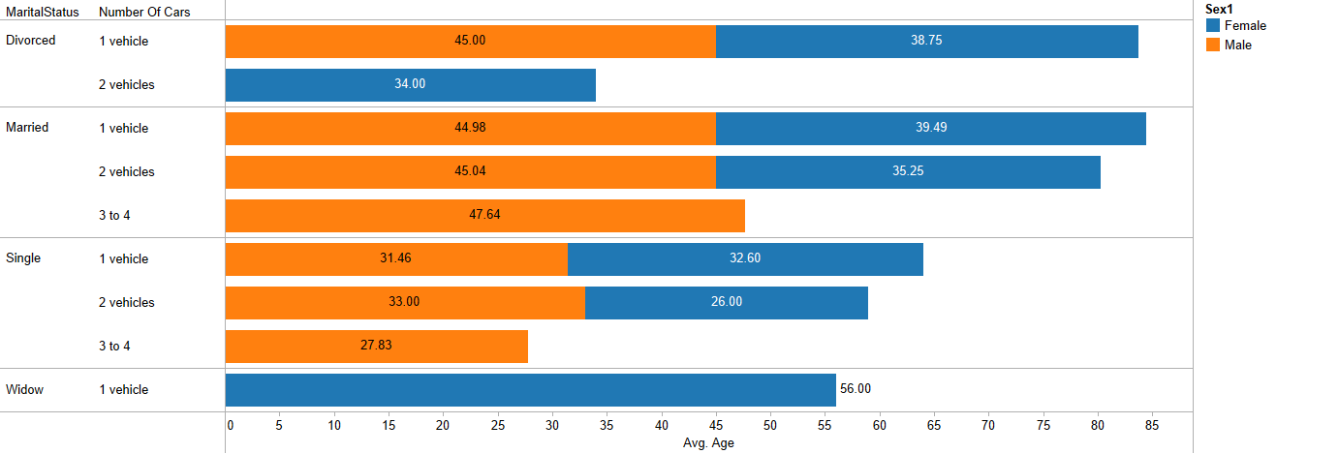
Fraudulent Claim characteristics

Slide 13
Is a claim more likely to be a fraudulent in the absence of a witness and if police report wasn’t filed?

Slide 14
Summary of findings
Majority of customers are Male with average age for Males of 41 and 37 for Females.
Majority of our policyholders are married
Top vehicle category is Sedan
Most preferred make is Pontiac
Year over Year, the accident claims are decreasing
Most common characteristics of a fraudulent claim are:
Committed mostly by married customers
Majority of then are males
Single car owners
Witness not present and Police report not filed

Slide 15
Conclusions
Number of accidents and related claims are on a decline YoY which implies a positive trend for the business
For car makers, the $20000 to $29000 seems to be the preferred car budgets for majority of the customers
Extra scrutinization needed for claims with single car owners
Additional caution required when a claim investigation finds no witness or police reports

Slide 16
End of Presentation

